Slide 1
Supporting reading
Making text accessible for learners with reading difficulties

Slide 2
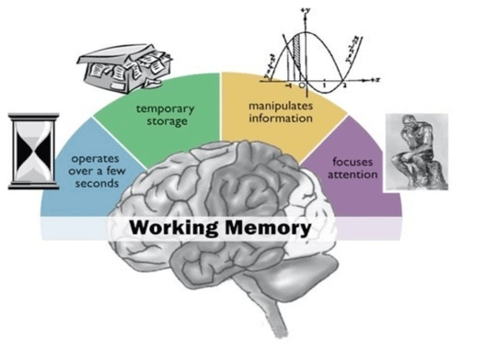
Learners with Specific Learning Difficulties
Working memory difficulty
Reading accuracy difficulty
May have difficulties with reading for 2 main reasons
Reading accuracy errors
– misreading letter patterns
- word substitutions – thinking that they see a word but it is actually incorrect
Working memory – reading accuracy OK, but effortful. The text is not remembered in detail.

Slide 3
Shared reading
Wendy Griswold reminds us of the pleasures of reading, which I call the four E’s: escape, enjoyment, entertainment, and enlightenment. (Griswold, 2008)
Do
Little and often
Take it in turns to read out loud
Do character voices if you can
Read the bigger share (most of it!)
Chat about the story
Give a correct word gently, without breaking the sentence flow
Don’t
Make it like a read out loud exam
Nag ☺

Slide 4
Audio books

Slide 5
Digital texts + text to speech
Text books
Class texts/anthology in English lessons
Reading for enjoyment – ibooks, pdf or epub (with an app)

Slide 6
Text to speech on Kindle with Bluetooth speaker

Slide 7
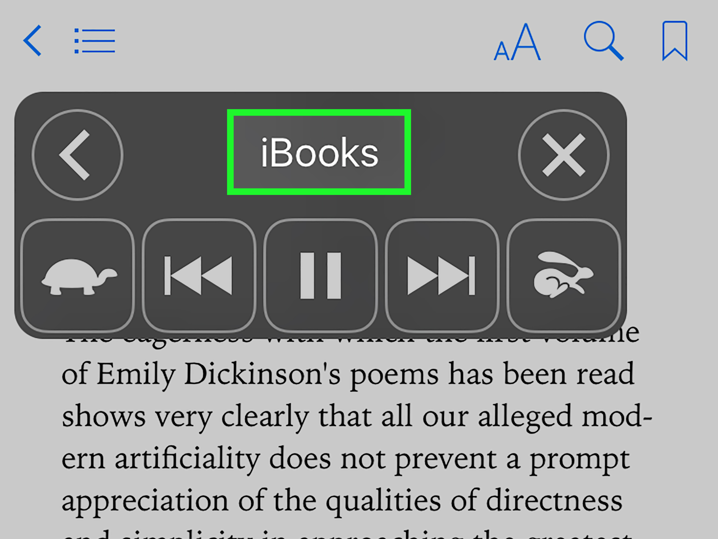
iBooks, iPhone, iPad
How to turn on text to speech
iOS includes powerful text-to-speech options that allow you to easily have selected text read back to you, in a wide variety of languages and accents. If you're using iOS 8 or later, there's also the very useful Speak Screen function, which will even automatically turn the pages on your ebook as it reads to you.

Slide 8
Android phones/tablets Kindle app
Using the Talkback feature in Accessibility

Slide 9
Text to speech on a Kindle Fire
Link to Amazon here

Slide 10
Kindle paperwhite 4 text to speech

Slide 11
Amazon Echo + Alexa
Navigate in the Alexa companion app under the new Kindle Books section to see which of your titles Alexa can read to you It’s not as nice as a real human voice, but it also doesn’t cost you anything extra.
The easiest way is just to say, “Alexa, read Niche Down to me.” Any Kindle book in your library that hasn’t turned this feature off will work, including books you borrowed from libraries or friends.
But if you want to know the nuts and bolts, here’s how to do it in the Alexa app.
Go to the menu and select Music, Video, & Books.
Under Books, select Kindle.
Choose an available device from the drop-down menu before selecting a title.

Slide 12
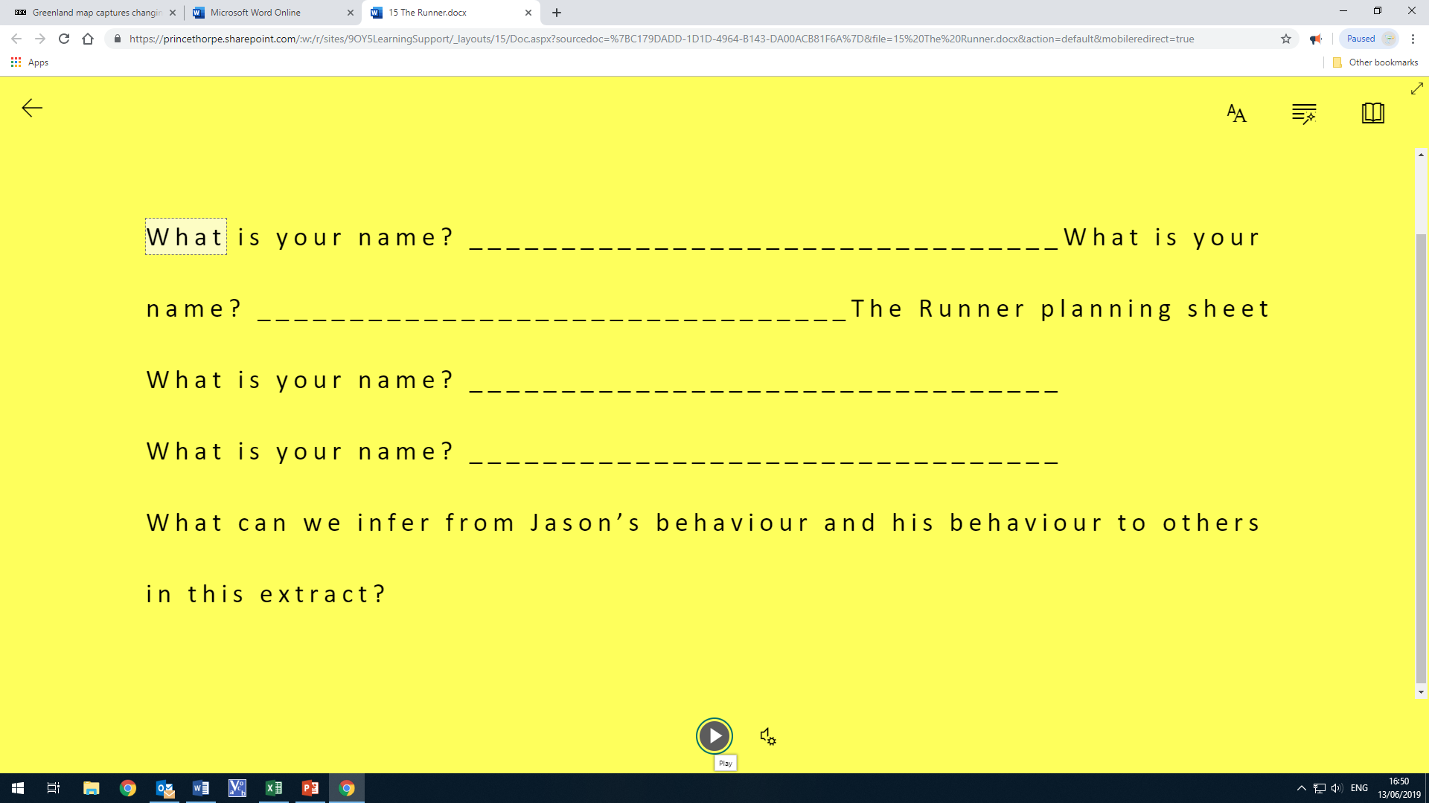
Microsoft Office 365 Immersive Reader

Slide 13
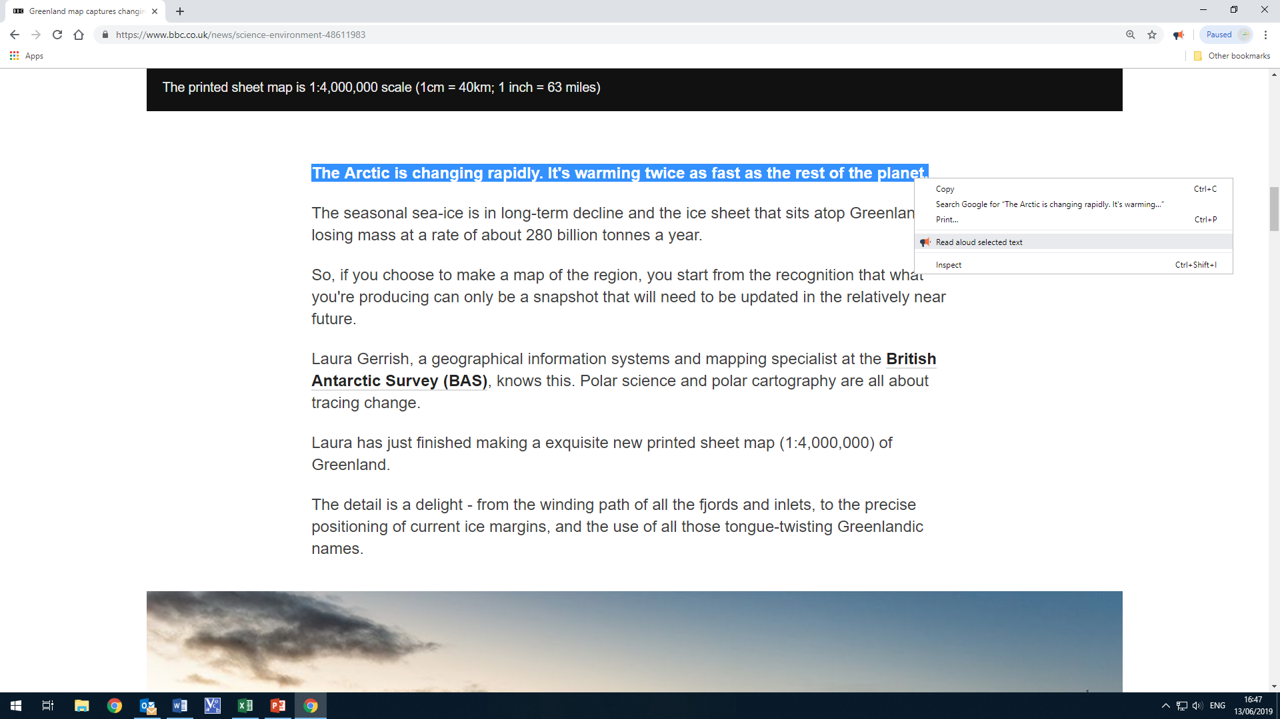
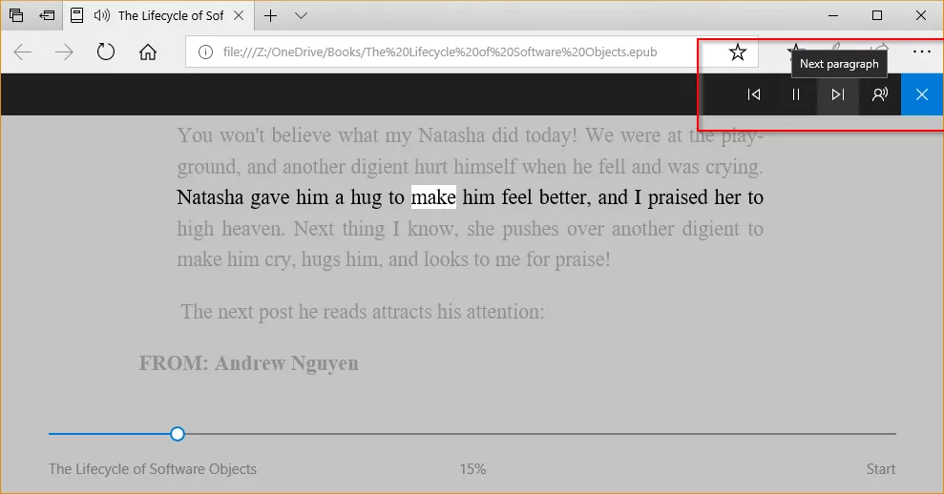
Browser text to speech
Chrome extensions
Read Aloud
ClaroRead
Edge
ReadAloud

Slide 14
Microsoft Edge

Slide 15
ClaroRead for Chrome

Slide 16
Read aloud functionality
Windows 10 Narrator

